Slide 1
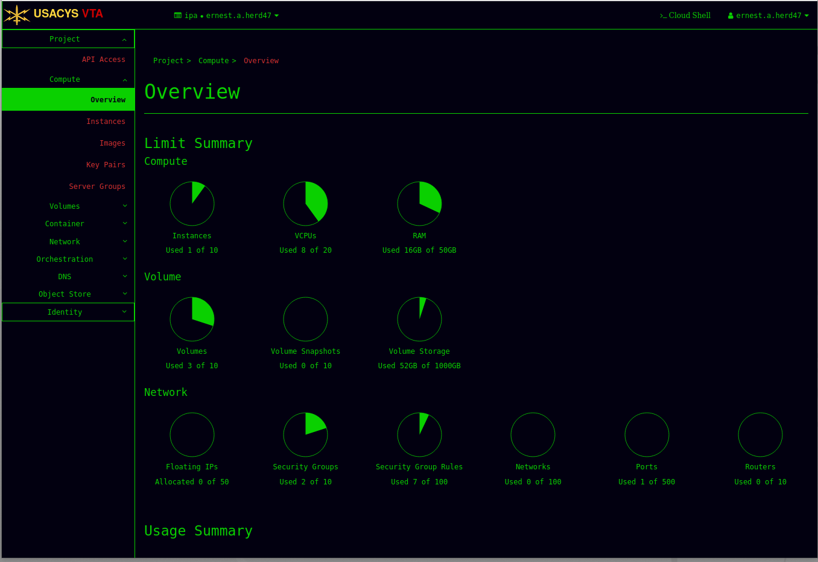
Virtual Training Area Access

Slide 2
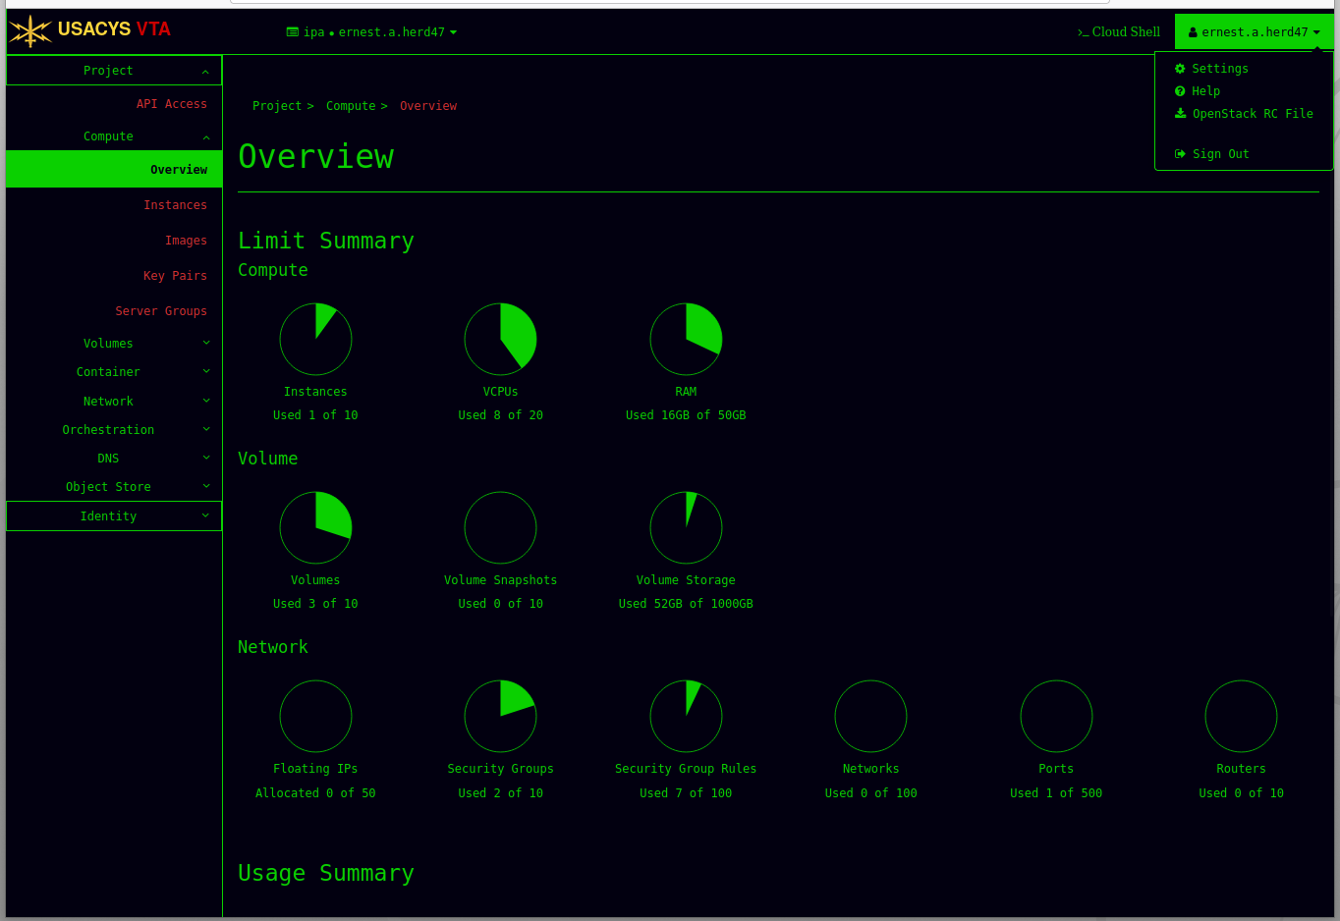
Changing your password (1)

Slide 3
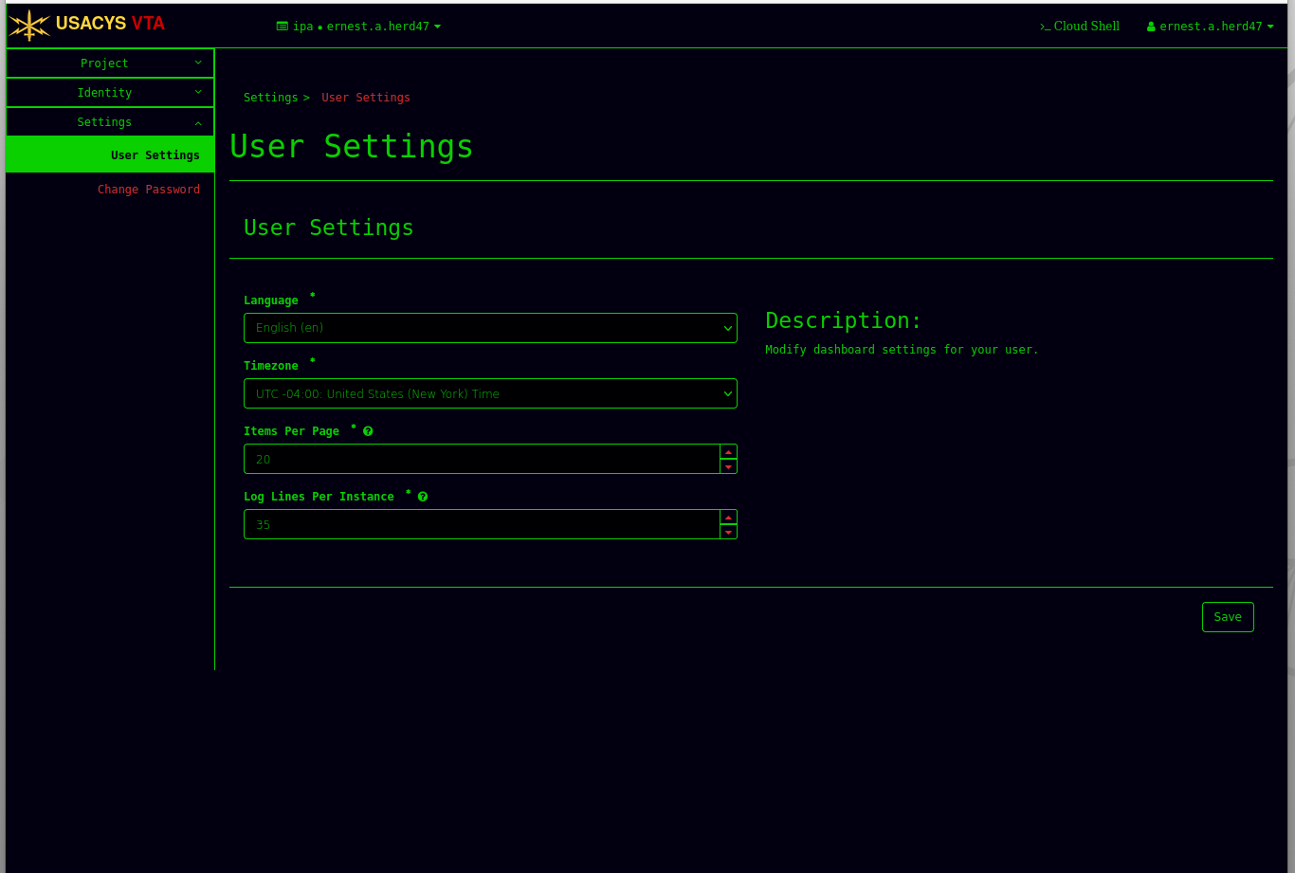
Changing Your Password (2)

Slide 4
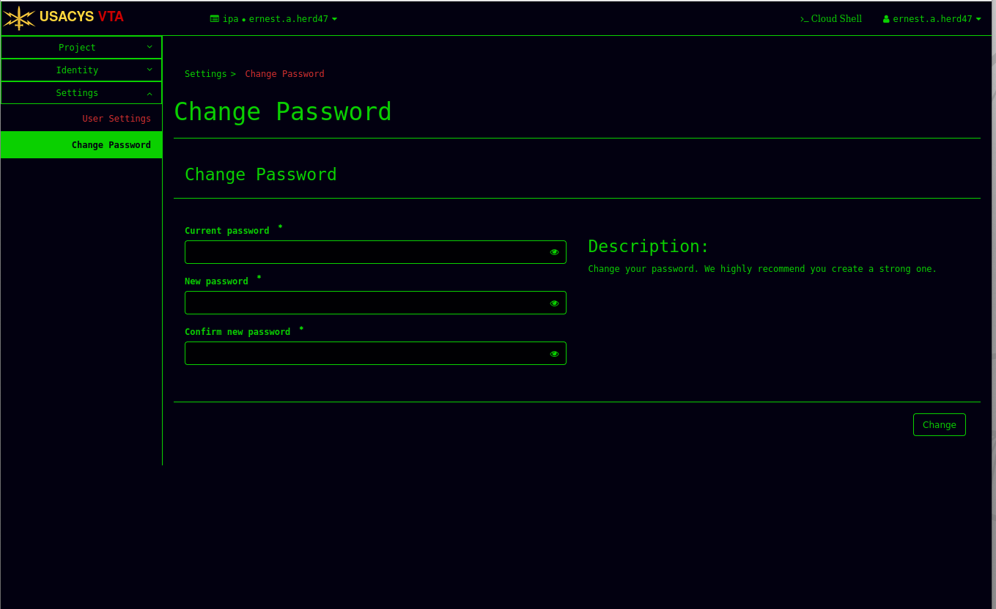
Changing Your Password (3)

Slide 5
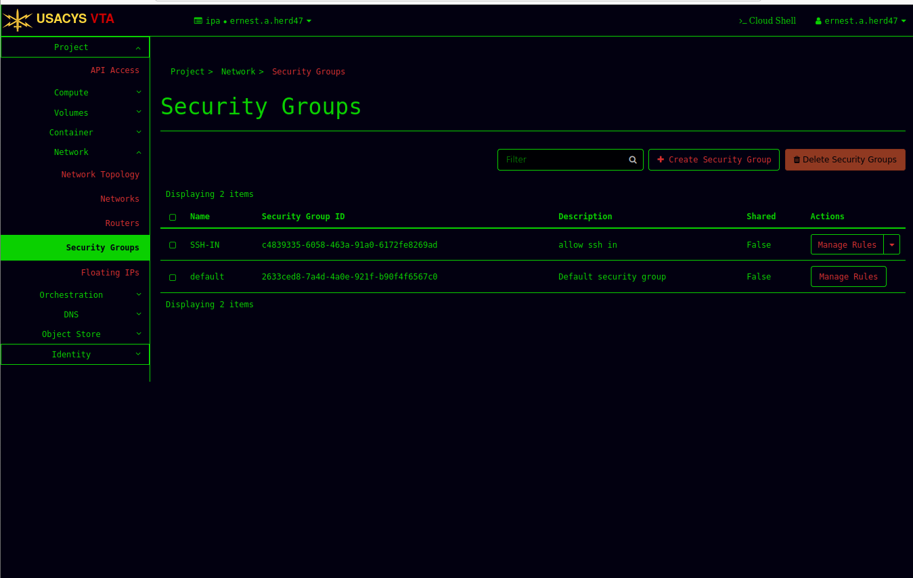
Modifying your Security Group

Slide 6
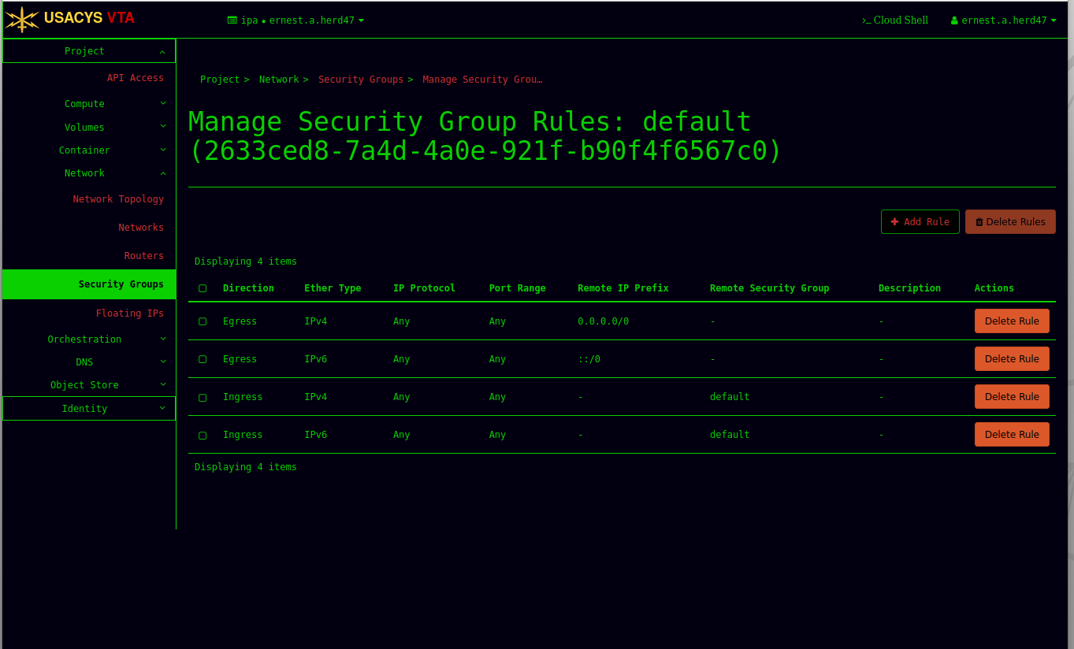
Add Rule

Slide 7
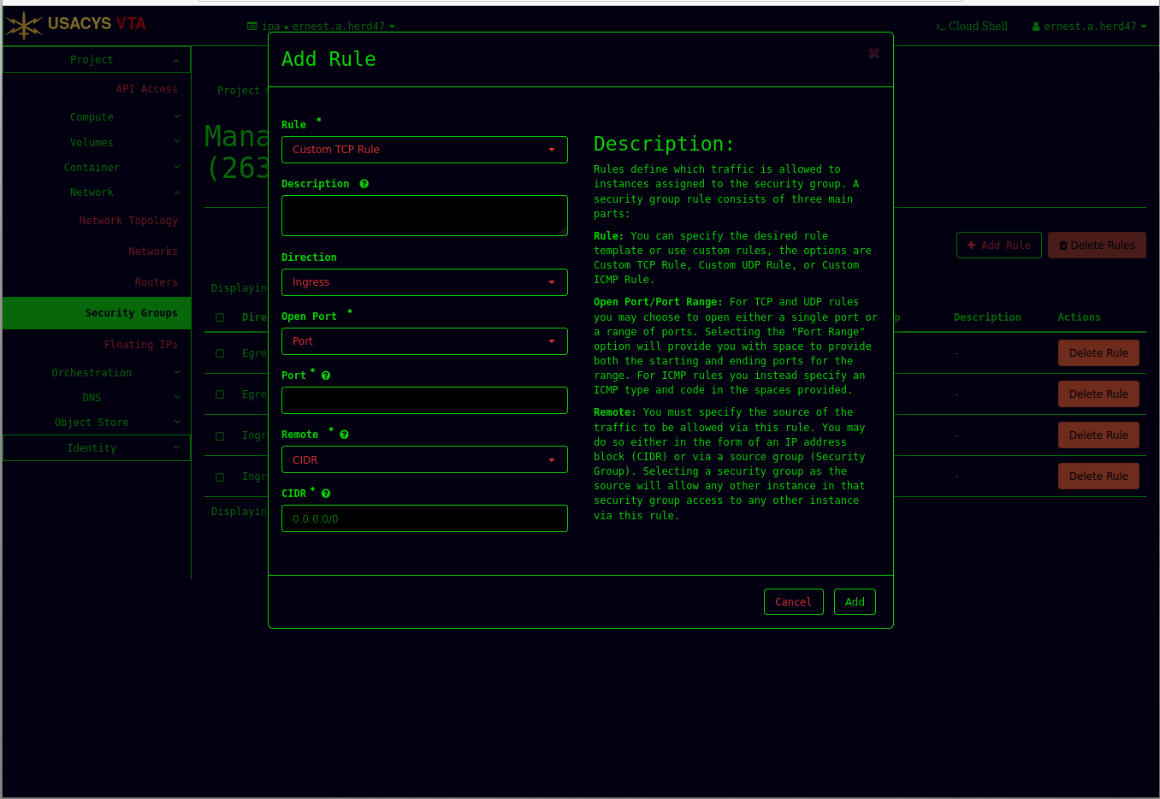
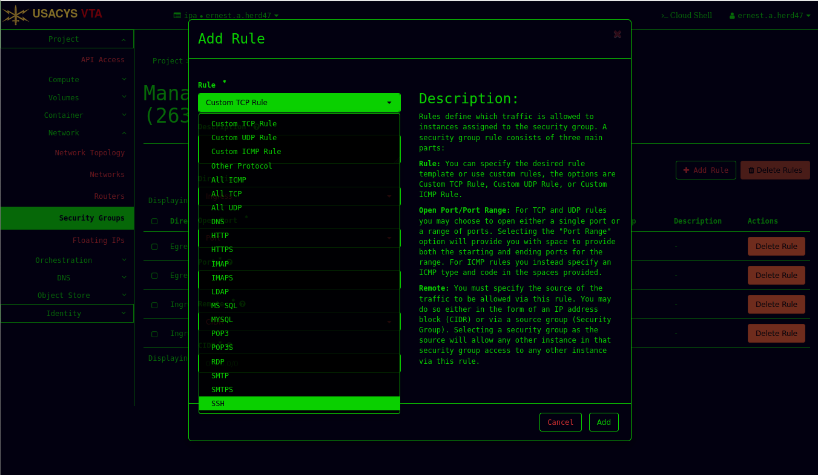
Select Rule Type

Slide 8
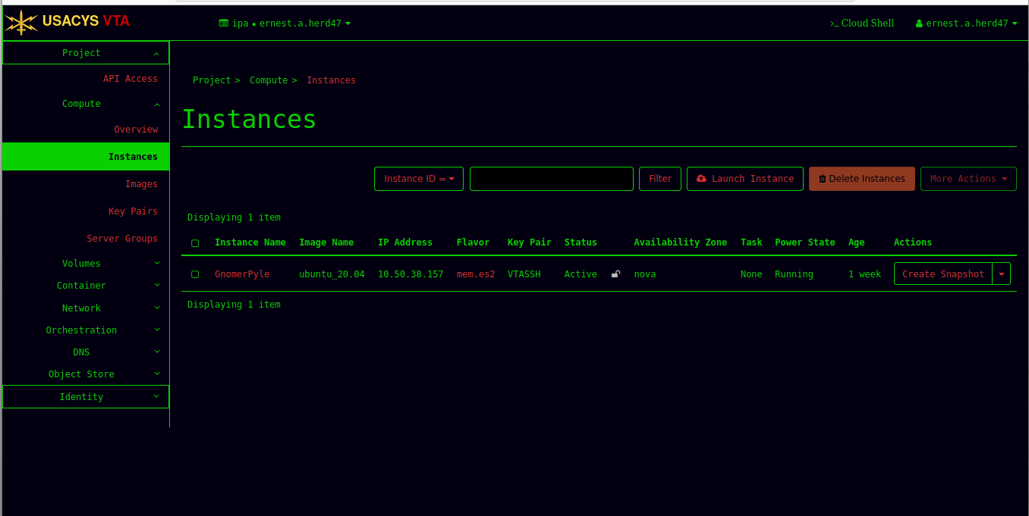
Creating your VM

Slide 9
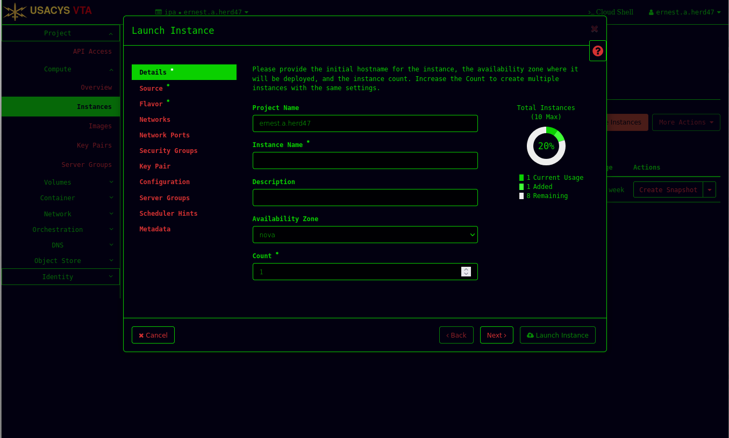
Give Your Instance (VM) A Name

Slide 10
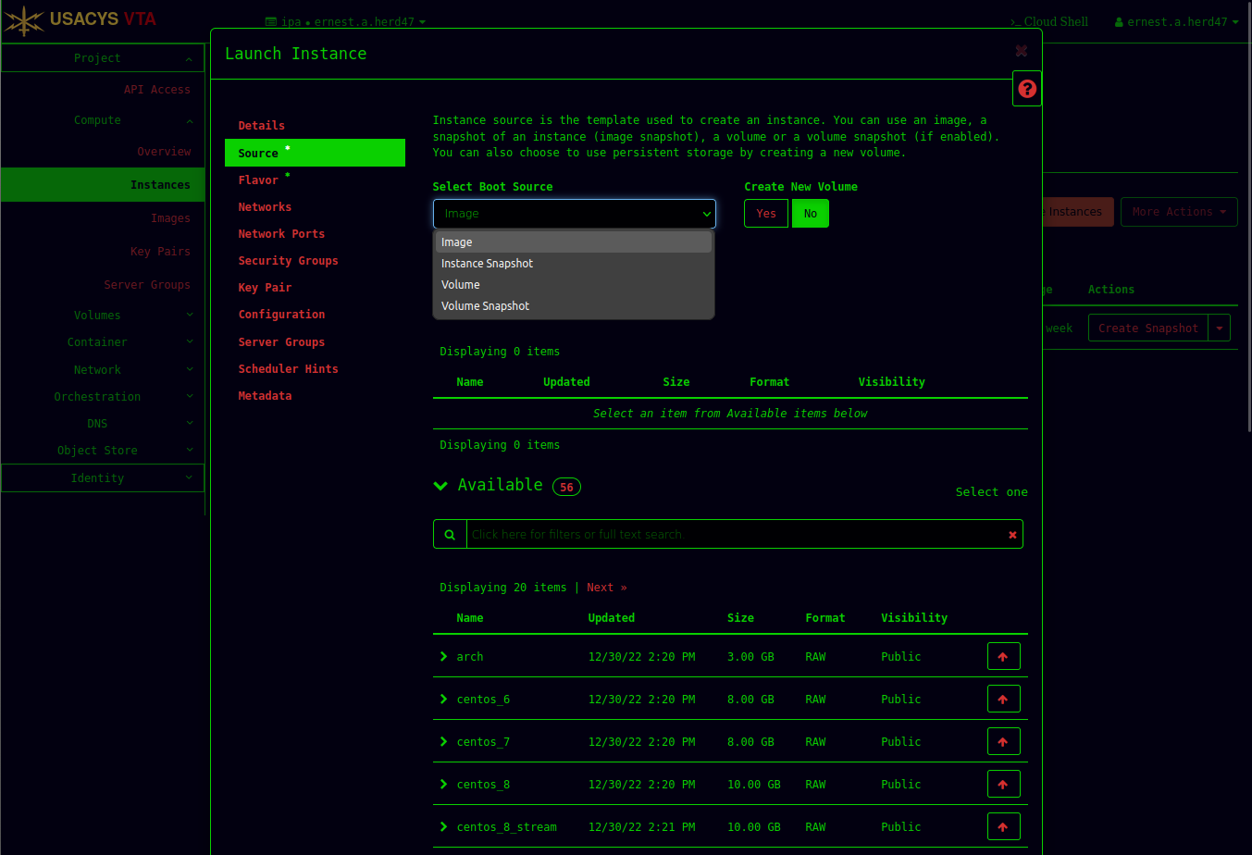
Select the Boot Source

Slide 11
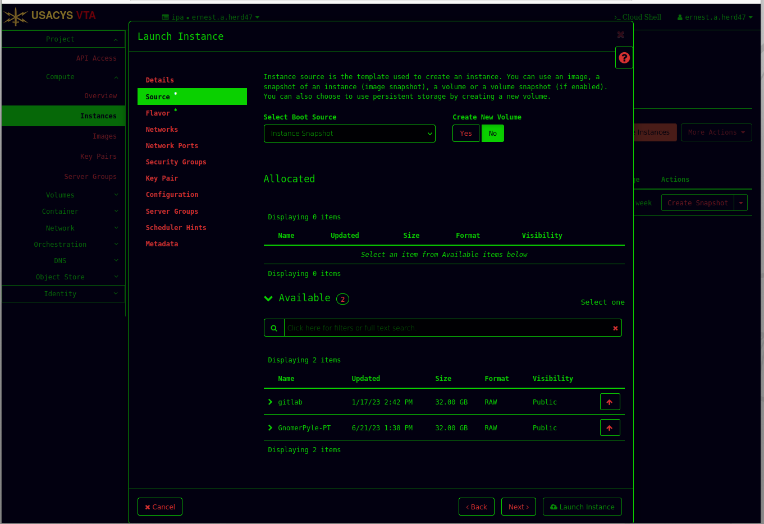
Choose Your Snapshot

Slide 12
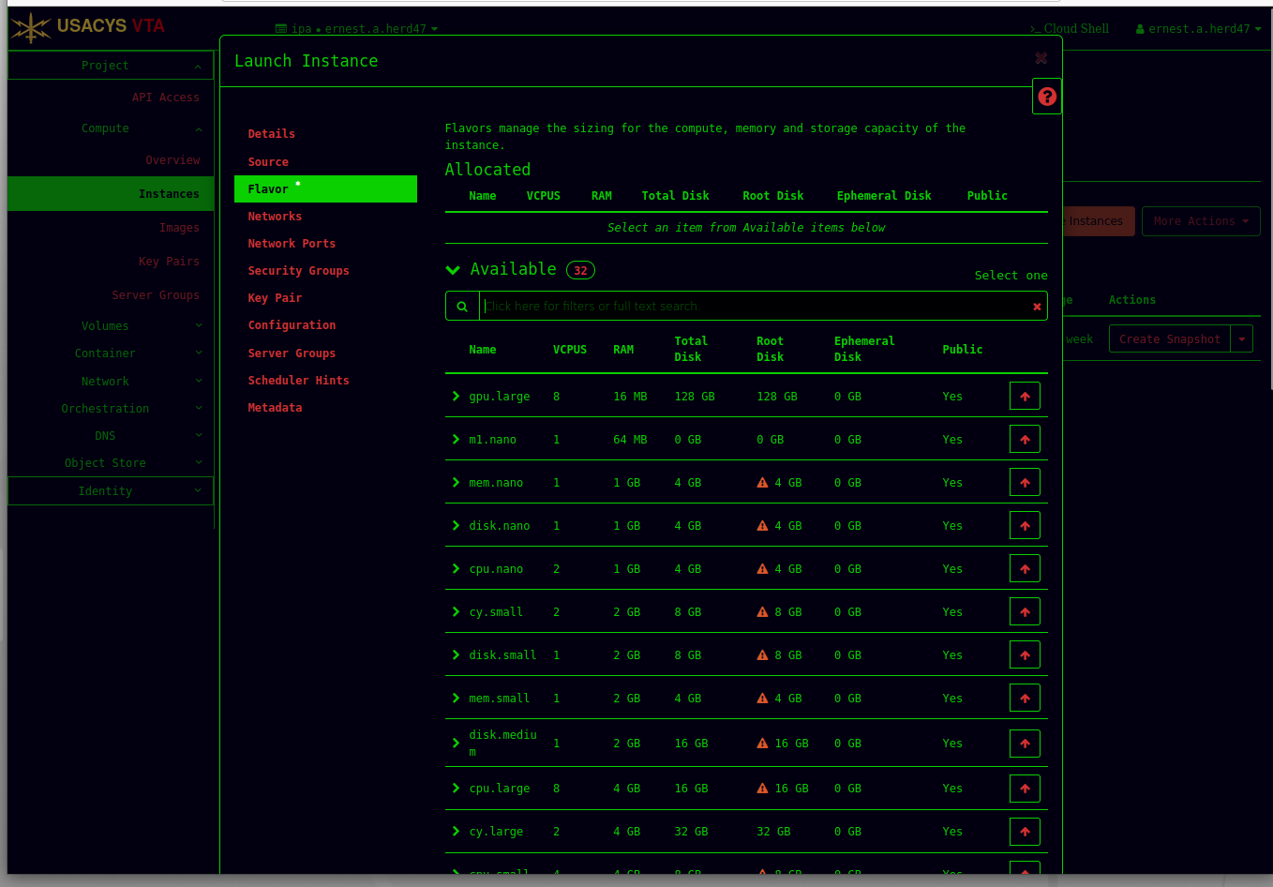
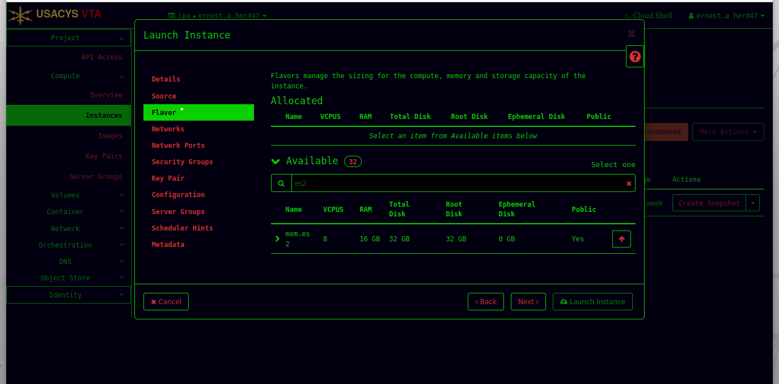
Choose the “Flavor” (hardware)

Slide 13
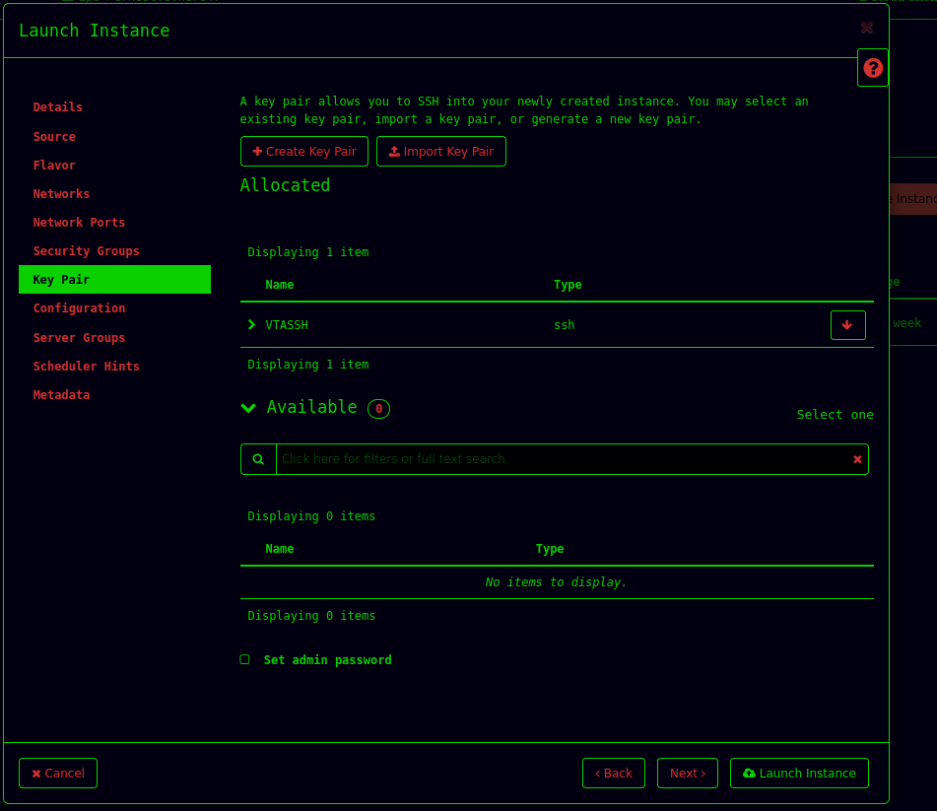
Create an SSH Key Pair

Slide 14
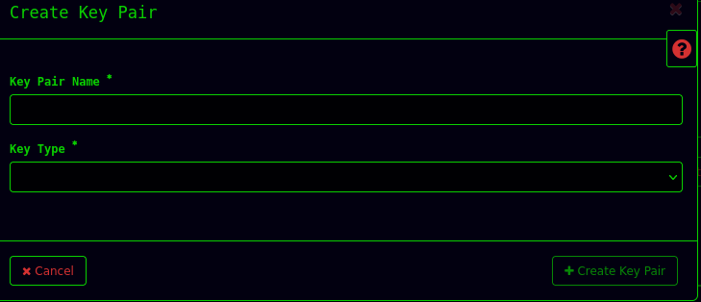
Give the Key Pair a Name (id_rsa) and Click “Create Keypair
id_rsa
SSH

Slide 15
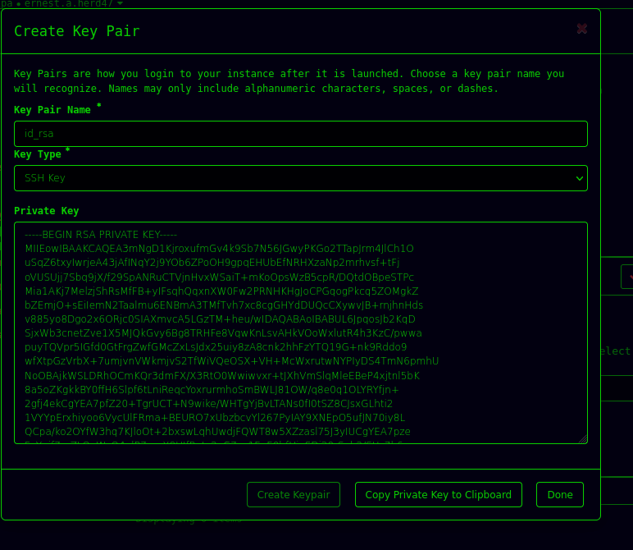
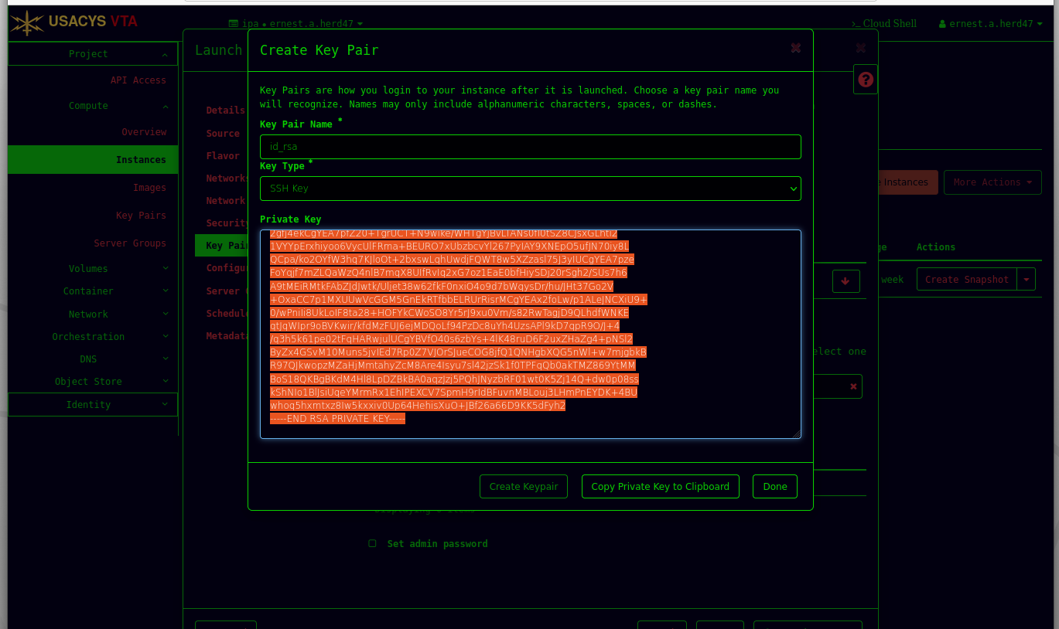
Click “Copy Private Key to Clipboard”

Slide 16
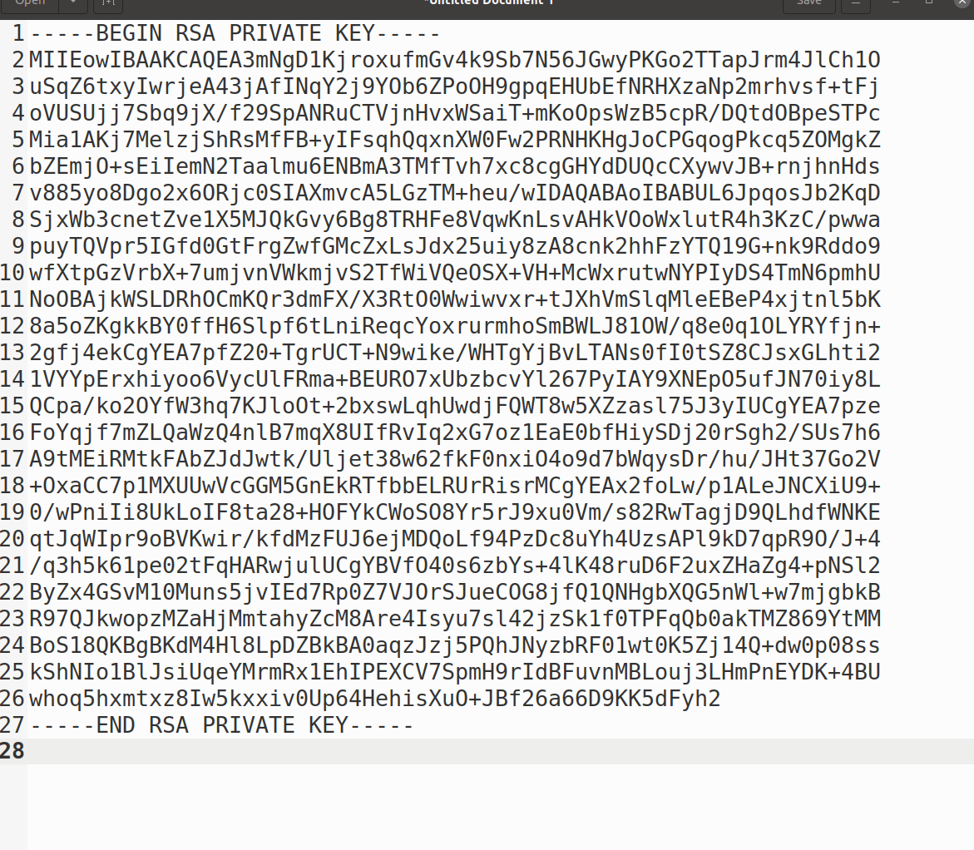
Open Text Editor and Paste Copied Characters

Slide 17
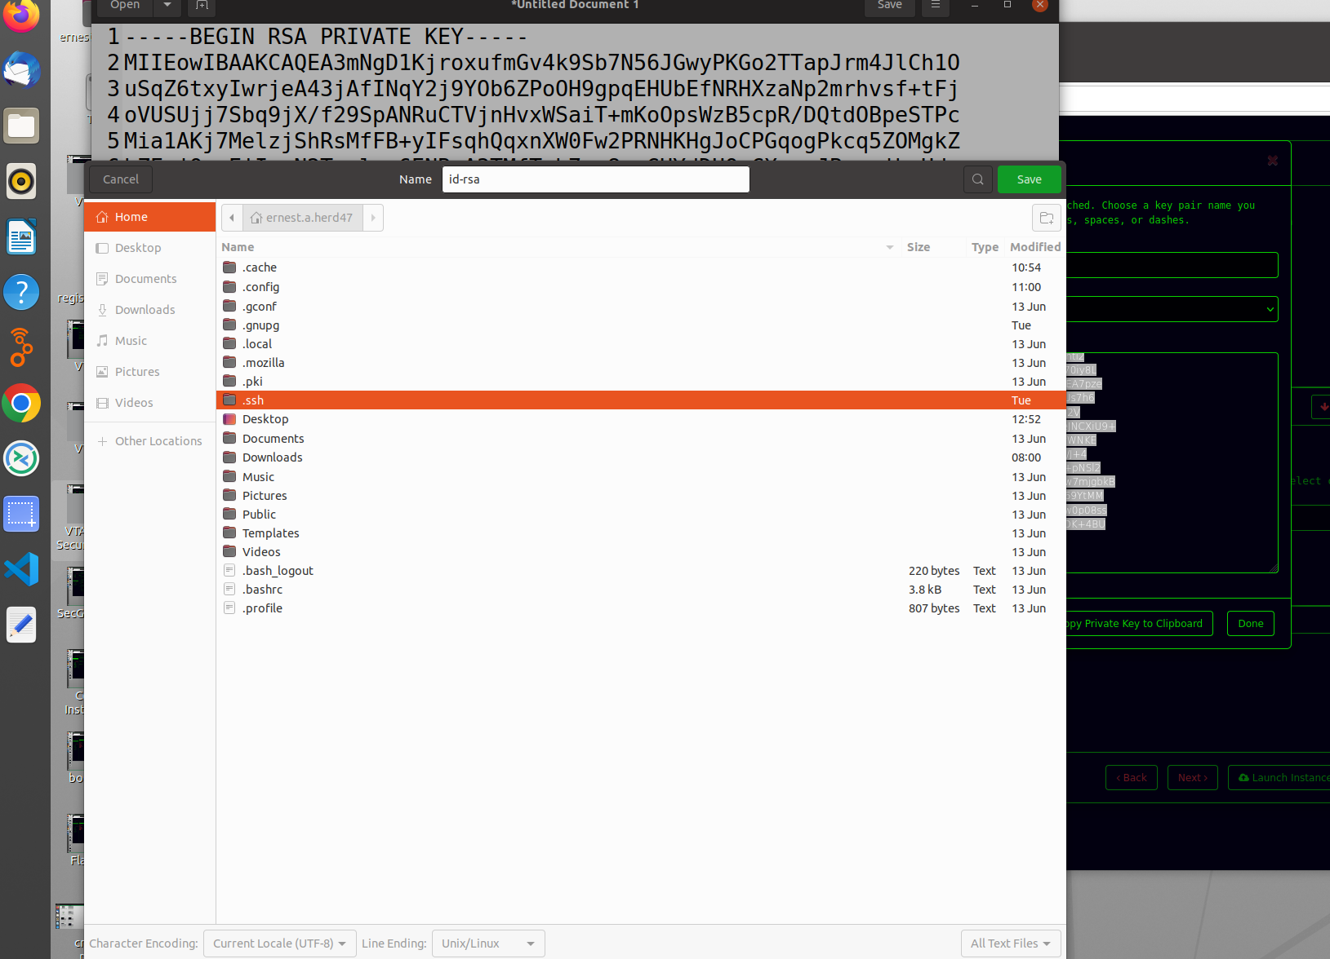
Save it as id_rsa into the .ssh directory

Slide 18
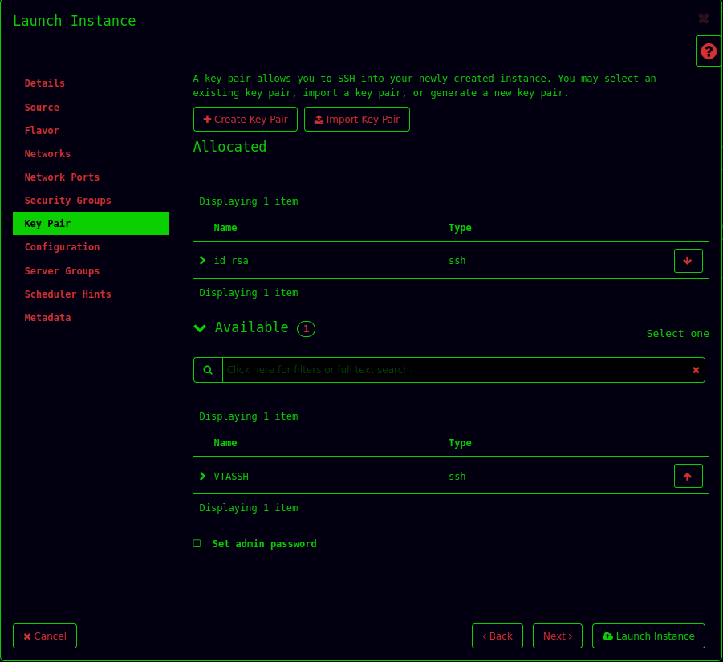
Click Launch Instance
Your VM will now be created.
It may take several minutes.

Slide 19
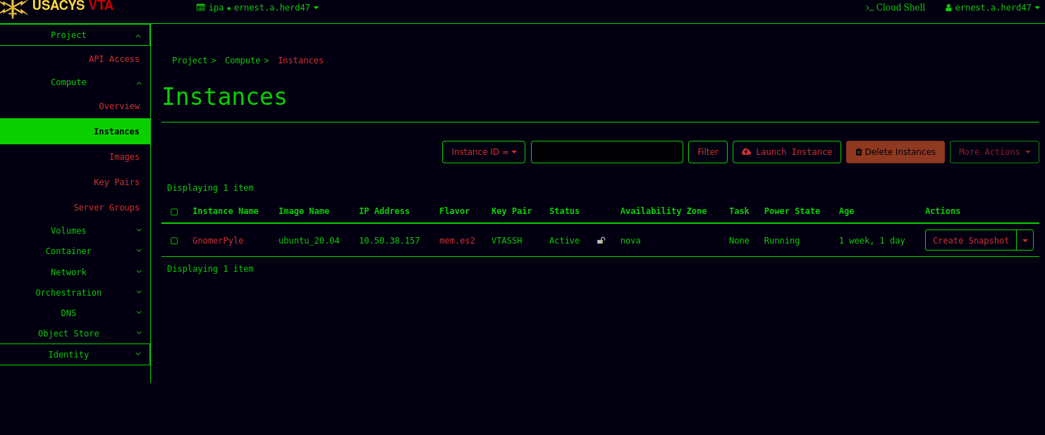
Record your IP address

